Slide 1
Lecture 7
Components of Cloud Computing

Slide 2
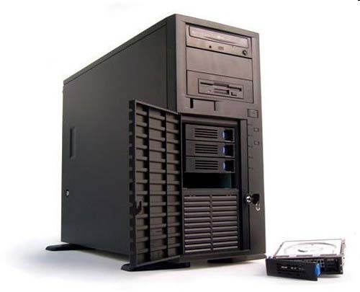
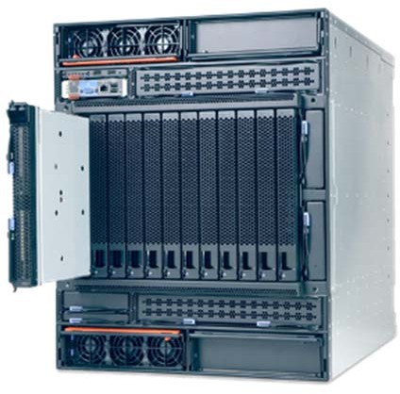
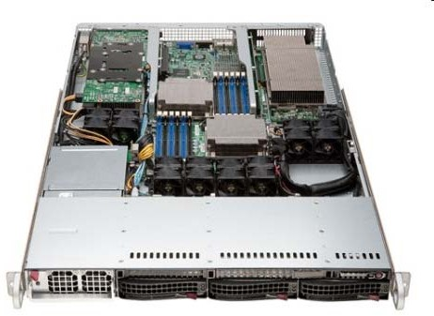
What is a Server?
Servers are computers that provide “services” to “clients”
They are typically designed for reliability and to service a large number of requests
Organizations typically require many physical servers to provide various services (Web, Email, Database, etc.)
Server hardware is becoming more powerful and compact

Slide 3
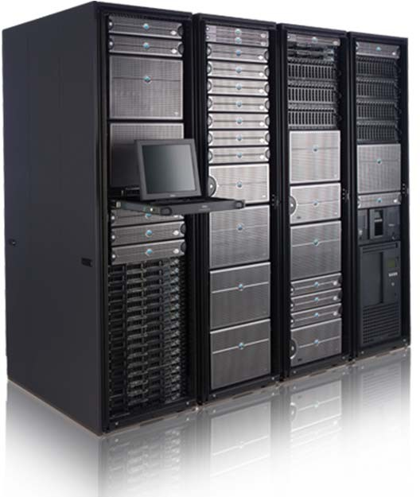
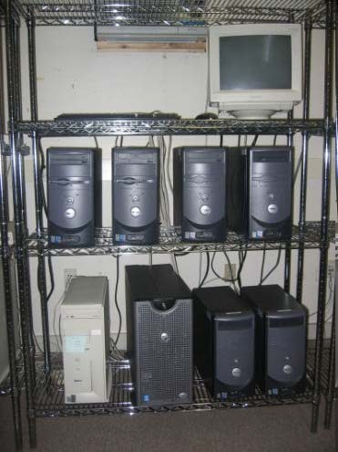
Compact Servers
Organizations would like to conserve the amount of floor space dedicated to their computer infrastructure
For large-scale installations, compact servers are used. This helps with:
Floor Space
Manageability
Scalability
Power and Cooling

Slide 4
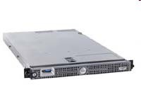
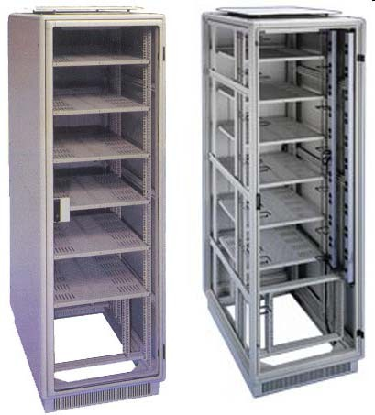
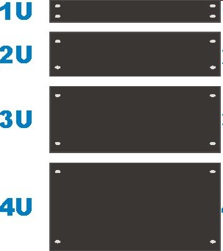
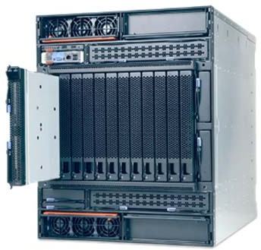
Racks
Equipment (e.g., servers) are typically placed in racks
Equipment are designed in a modular fashion to fit into rack units (1U, 2U etc.)
A single rack can hold up to 42 1U servers
1U Server
7U Blade center

Slide 5

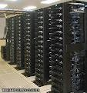
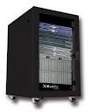
Blades and Blade Enclosures
A blade server is a stripped down computer with a modular design
A blade enclosure holds multiple blade servers and provides power, interfaces and cooling for the individual blade servers

Slide 6
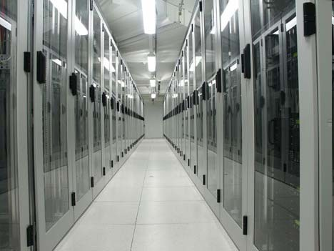
What is a Data Center?
A data center is a facility used to house computer systems and associated components, such as networking and
storage systems, cooling, uninterruptable power supply, air filters…
A data center typically houses a large number of heterogeneous networked computer systems
A data center can occupy one room of a building, one or more floors, or an
entire building

Slide 7
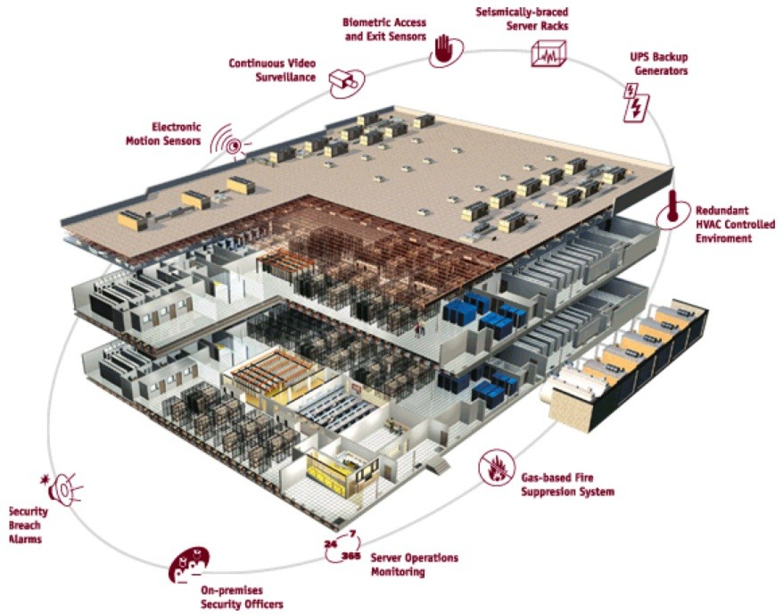
Data Center Components
Air conditioning
Keep all components in the manufacturer’s recommended temperature range
Redundant Power
UPS/Generators
Multiple power feeds
Fire protection
Physical security
CCTV/Access Control
Monitoring Systems
Connectivity
Multiple ISPs/Leased Lines

Slide 8
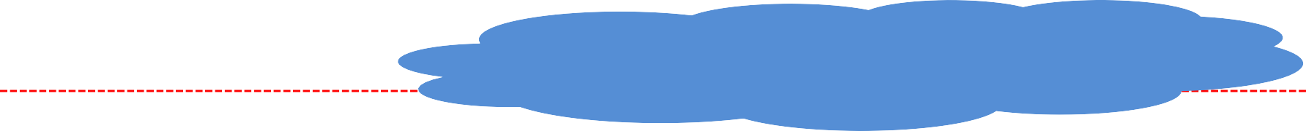
The Network of a Modern Data Center
Internet
CR
CR
Layer 3
AR
AR
AR
AR
LB
S
S
LB
…
Layer 2
S
S
S
S
A
A
… A
A
A
… A
CR = L3 Core Router, AR = L3 Access Router, S = L2 Switch, LB = Load Balancer,
_{© Carnegie M}A_{ello}=_{n U}R_{niv}a_{e}c_{rs}k_{ity}o_{in}f_{Q}2_{at}0_{ar} servers (Cisco with ~ 4,000 servers)
12

Slide 9
Communication In Data Centers
Communication in data centers are most often based on networks running the IP protocol suite
Data centers contain a set of routers and switches that transport traffic between the servers and to the outside world
Traffic in today’s data centers:
80% of the packets stay inside the data center
Trend is towards even more internal communication
Typically, data centers run two kinds of applications:
Outward facing (serving web pages to users)
Internal computation (data mining and index computations–think of MapReduce and HPC)

Slide 10
Communication Latency
Propagation delay in the data center is essentially 0
Light goes a foot in a nanosecond
End to end latency comes from
Switching latency
10G to 10G:~ 2.5 usec (store&fwd); 2 usec (cut-thru)
Queuing latency
Depends on size of queues and network load
Typical times across a quiet data center: 10-20usec

Slide 11
Elasticity and Performance
Bare data centers make it hard for applications to grow/shrink
VLANs can be used to isolate applications from each other
IP addresses are topologically determined by Access Routers
Reconfiguration of IPs and VLAN trunks is painful, error- prone, slow, and often manual
In addition, no performance isolation is provided:
VLANs typically provide reachability isolation only
One service sending/receiving too much traffic hurts all services sharing its subtree

Slide 12
Power in Data Centers
Pretty good data centers have efficiency of 1.7
0.7 Watts lost for each 1W delivered to the servers
How can we reduce power costs?
Create servers that use less power?
Conventional server uses 200 to 500W
Reductions have ripple effects across entire data center
Mostly a problem for scientists to tackle!!
Eliminate power redundancy?
Allow entire data centers to fail
Reduce power usage of network gear?
Total power consumed by switches amortizes to 10-20W per server

Slide 13
Utilization In Data Centers
Utilization of 10% to 30% is considered “good” in data centers
Causes:
Uneven application fit:
Each server has CPU, memory, and disk: most applications exhaust one resource, stranding the others
Long provisioning timescales
Uncertainty in demand:
Demand for a new service can spike quickly
Risk management:
Not having spare servers to meet application demands leads to failure

Slide 14
What About?
Maximize useful work per dollar spent – 59% of dollars are spent on servers with very low utilization (10%)
Turn the servers into a single large resource pool and let services “breathe” : dynamically expand and contract their footprint
as needed
Two main requirements:
Enabled by Virtualization
Means for rapidly and dynamically satisfying application fluctuating resource needs
Enabled by Programming Models and Distributed File Systems
Means for servers to quickly and reliably access shared and persistent data
Data too large to copy during provisioning process

